Slide 1
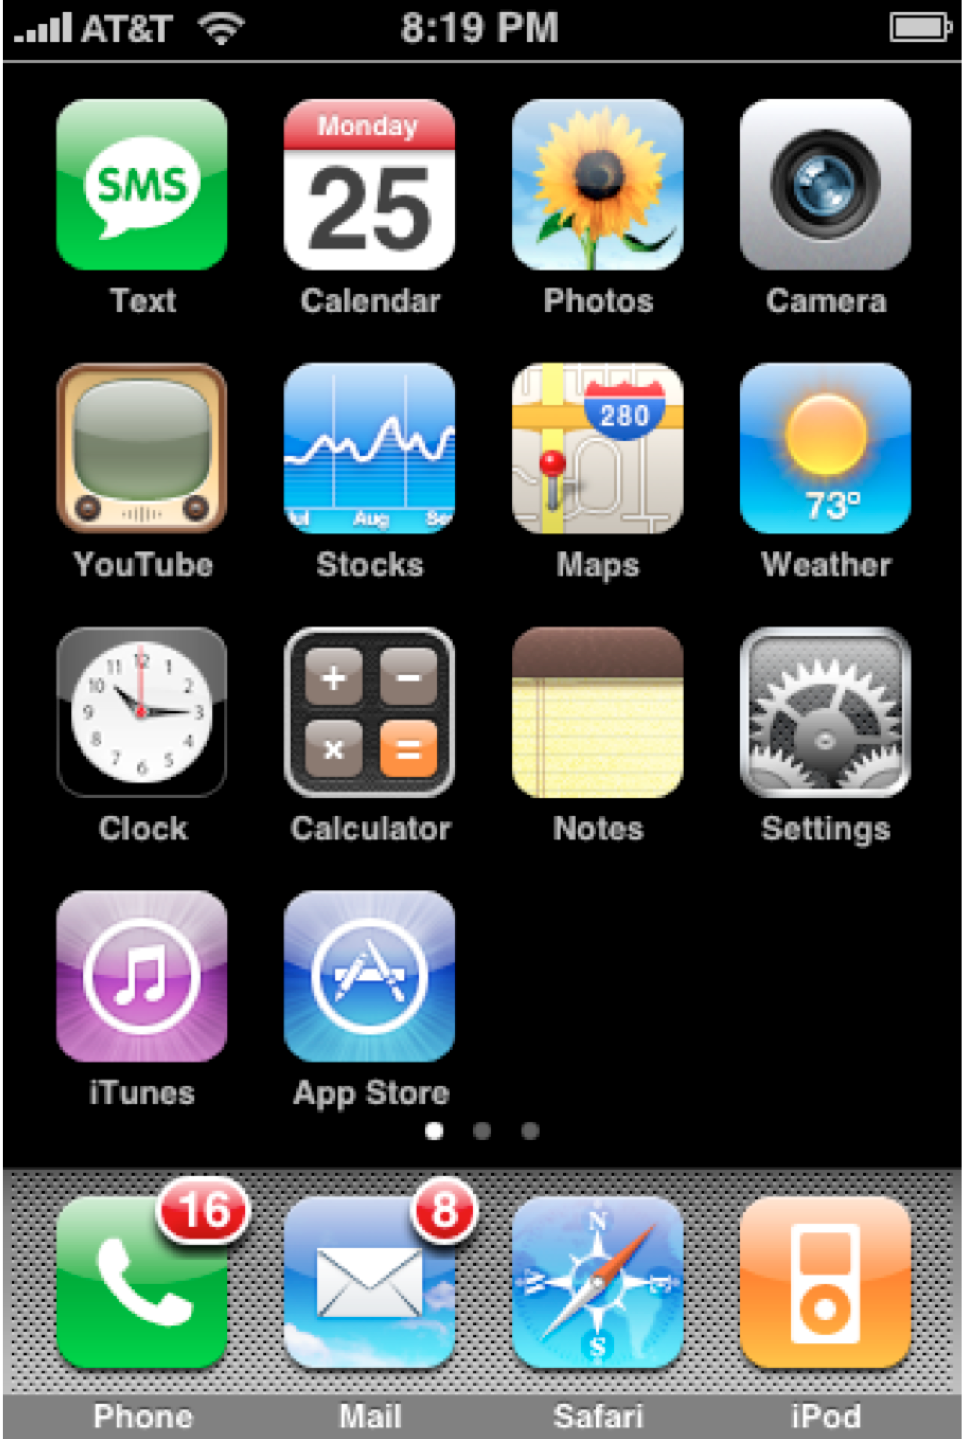
USER STUDY

Slide 3
Notes:
Resize (grow)

Slide 4
Notes:
Resize (shrink)

Slide 5
Notes:
Rotate

Slide 6
Notes:
Slide

